Slide 1




Bluestock Mutual Fund Analytics: End-to-End Data Pipeline & Intelligence Dashboard
Presented By- M Jitendra
Date-12 June, 2026

Slide 2


CONTENTS
01
Introduction
07
Quantitative Risk: VaR & CVaR
02
The Business Problem & Objective
08
Performance Trends: Rolling Sharpe
03
Data Architecture & Pipeline
09
Investor Behavior & Demographics
04
Challenges: Synthetic Personas
10
Churn Analysis: SIP Continuity
05
Industry Overview & Market Share
11
Market Sentiment: Net Inflows
06
Fund Performance Scorecard
12
Future Roadmap & Q&A

Slide 3

Introduction
Hello everyone, my name is M Jitendra, and today I will be walking you through my capstone project. We transformed raw, disconnected mutual fund data into a predictive, automated business intelligence system.

Slide 4

The Business Problem & Objective
The Problem
Manual data processing causing significant reporting latency.
Siloed data sources preventing a 360° view of fund performance.
Absence of quantitative risk metrics (VaR/Sharpe) for decision support.
Zero visibility into investor churn and payment discontinuity patterns.
The Solution
End-to-end automated Python ETL pipeline for data integrity.
Kimball Star Schema architecture for optimized BI querying.
Advanced risk-modeling (95% VaR & Rolling Sharpe ratios).
Interactive, drill-through enabled Executive Dashboard.

Slide 5

Data Architecture & Pipeline
Raw CSVs
(Ingesting 8+ disparate CSV files, encompassing daily NAVs, transaction logs, and scheme metadata.)
Python/Pandas (ETL)
(Pandas-driven vectorization for data type casting, date normalization, and anomaly handling.)
SQLite (Star Schema)
(Star Schema architecture (Fact & Dimension tables) ensuring 1-to-Many referential integrity.)
Power BI
( Kimball Star Schema architecture (Fact & Dimension tables) ensuring 1-to-Many referential integrity.)

Slide 6

Challenges: Synthetic Personas
Business Intelligence Impact:
The Data Roadblock:
Upstream data anonymization protocols resulted in the complete removal of Primary User Identifiers (PII) from the raw transaction logs.
The engineering of synthetic personas transformed anonymized rows into trackable demographic units, directly enabling:
Cohort Analysis: Validating that mature cohorts contribute higher average SIP volumes over time.
Churn Prediction: Calculating the standard deviation of transaction gaps between "Healthy" and "At-Risk" segments.
Behavioral Mapping: Correlating geographic clusters with fund category net-inflow preferences.
Without a persistent ID, tracking longitudinal behavior and calculating cohort retention was mathematically impossible within the native dataset.

Slide 7


Industry Overview & Market Share
Macro-Level Key Performance Indicators:
Total AUM: ₹391.76 Lakh Crore managed across 40 distinct schemes.
Monthly SIP Inflows: Baseline of ₹32,778K, demonstrating strong retail participation.
Active Folio Count: Reached 60,000, indicating broad market penetration.
Market Dynamics and AMC Dominance:
Top-tier AMCs (SBI, ICICI, HDFC) control a significant portion of industry assets, reflecting brand trust. Capital momentum shows a consistent upward trend from 2022 to 2025 as retail investors shift from traditional savings to capital market instruments.

Slide 8
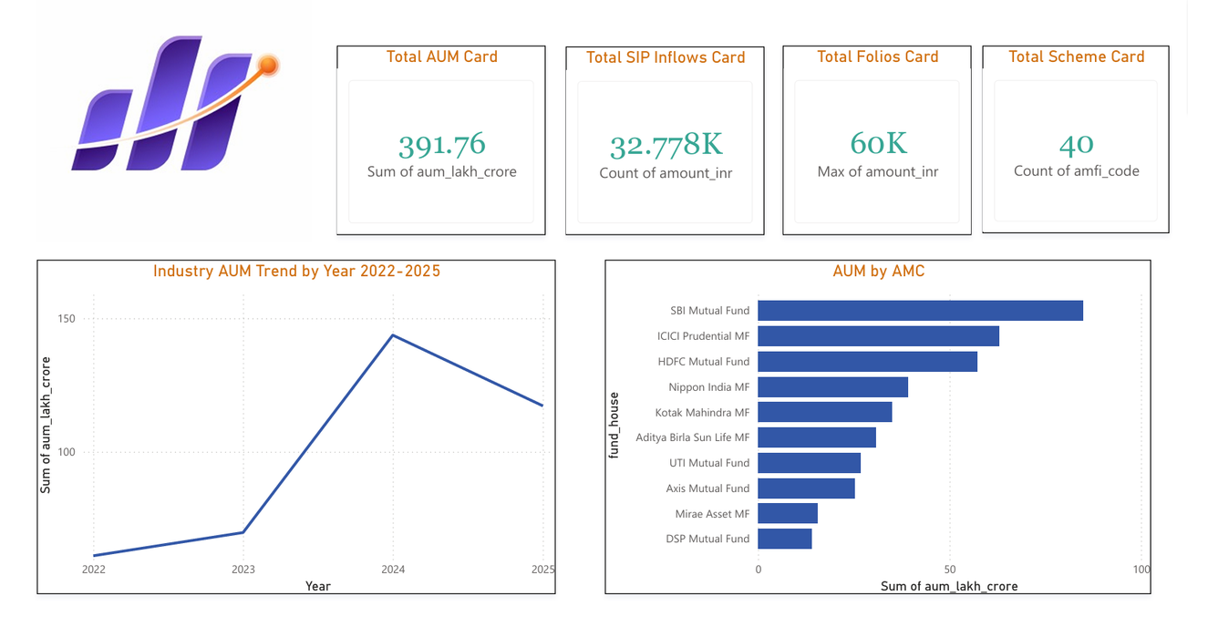
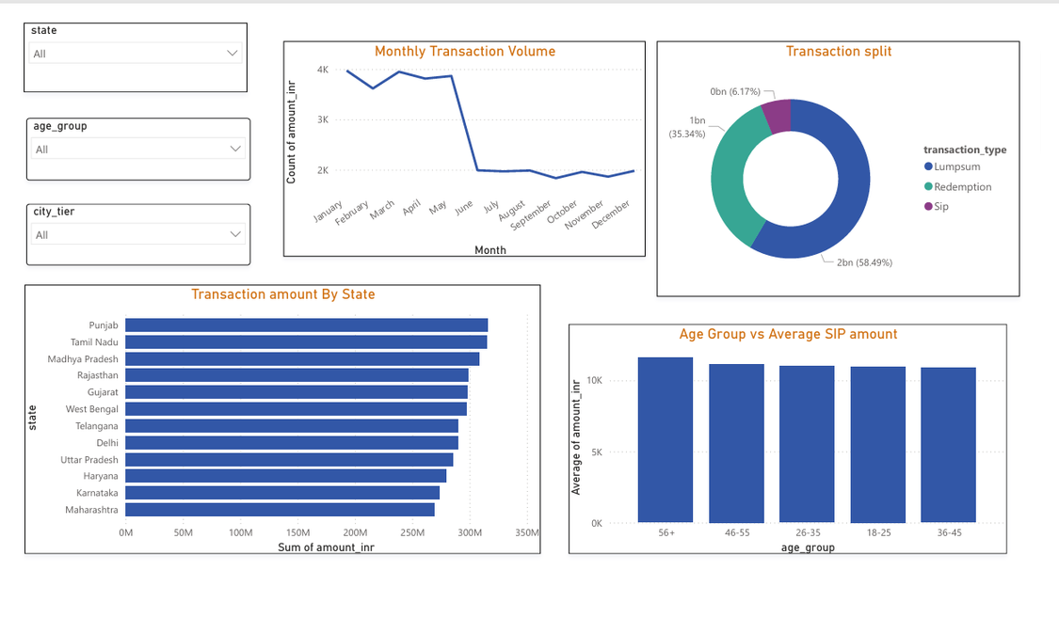
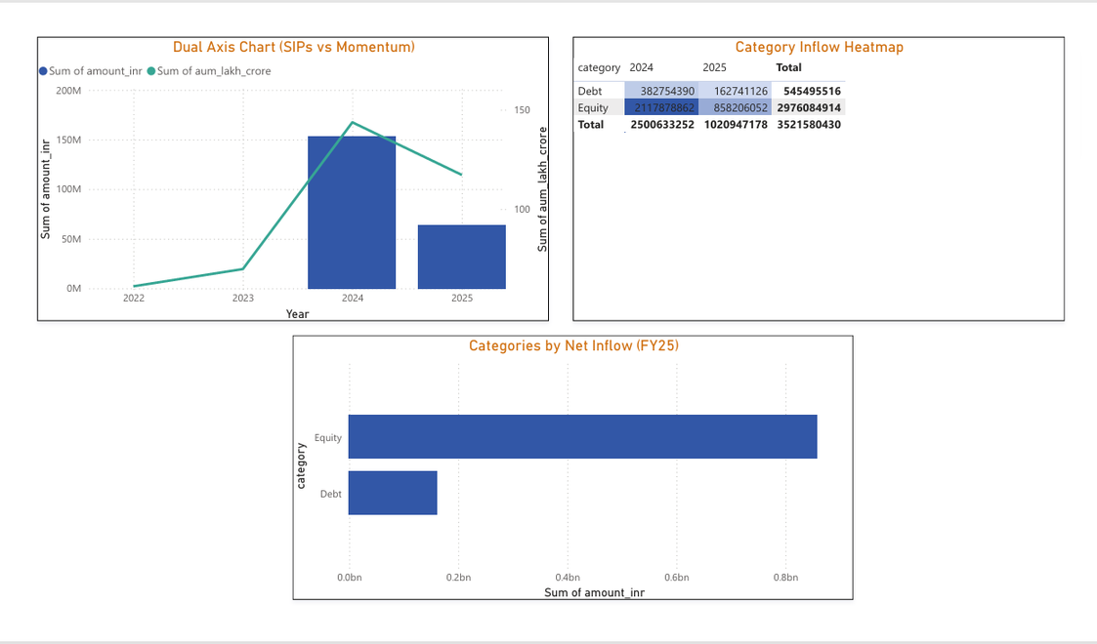
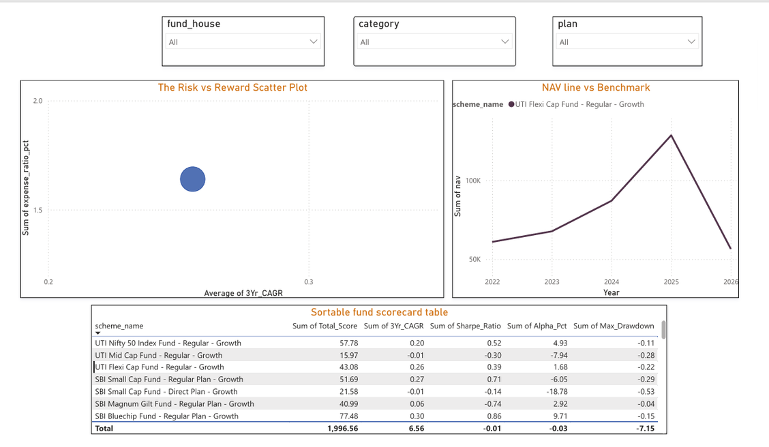

Slide 9

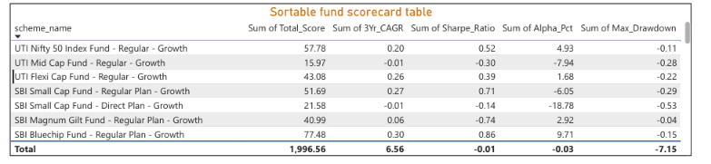
Fund Performance Scorecard
Risk-Adjusted Performance Ranking:
Evaluating the top-tier equity schemes across four critical quantitative dimensions: Alpha generation, Sharpe efficiency, CAGR growth, and tail-risk volatility.

Slide 10

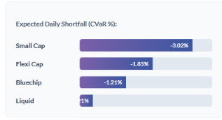
Quantitative Risk: VaR & CVaR
Tail Risk Analysis: VaR & CVaR:
Standard volatility metrics often fail to capture extreme downside risk. We utilized 95% Confidence Value at Risk (VaR) and Conditional VaR (CVaR) to model expected shortfalls.
Risk Mitigation Strategy:
The calculation of CVaR provides an essential prepare-for-worst-case perspective for wealth managers:
Tail Risk Isolation: Small Cap funds exhibited the highest tail risk, predicting more severe losses during bottom-5th-percentile market crashes.
Asset Allocation: CVaR scores suggest a higher allocation to Liquid and Gilt instruments for risk-averse portfolios to buffer against "Black Swan" events.
Diversification: Mitigating concentration risk through broad category exposure to lower overall portfolio HHI.

Slide 11
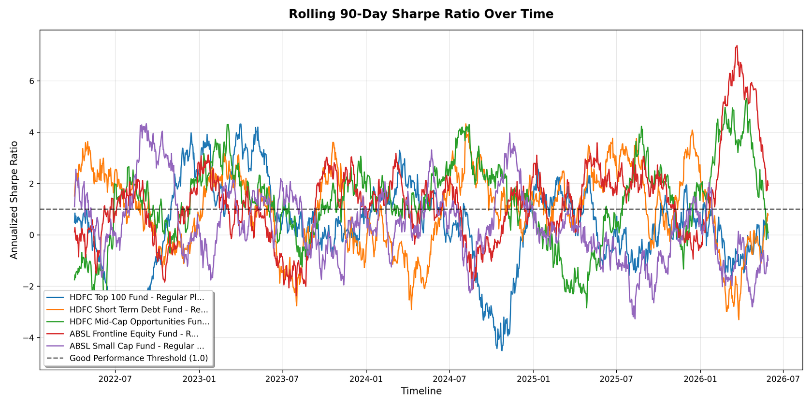
Performance Trends: Rolling Sharpe
Dynamic Risk-Adjusted Returns:
Static 3-year metrics often mask significant intra-year volatility. By engineering a Rolling 90-Day Sharpe Ratio, we track how efficiently a fund generates returns relative to risk over dynamic cycles.
.
Strategic Utility of Rolling Metrics:
Underperformance Triggers: Identifying specific market phases where fund managers fail to deliver risk-adjusted alpha.
Normalization: Calculating performance while adjusting for trailing 90-day standard deviation.

Slide 12
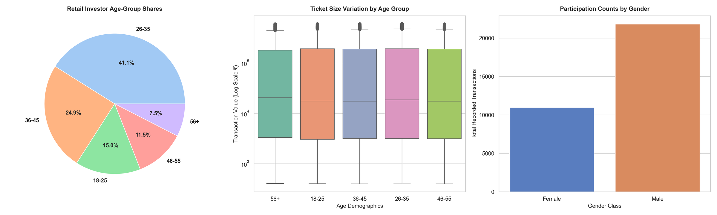
Investor Behavior & Demographics
Regional Transaction Volume:
Capital inflows are heavily skewed toward high-tier financial centers. Maharashtra and Delhi emerge as the primary engines of transaction volume, together contributing over 40% of the organic growth footprint.
Demographic Resilience:
Commitment Stability: Average SIP amounts remain consistent across 25–45 demographics (~₹11,000).
Mature Cohorts: Investors aged 46+ show a 15% higher retention rate during periods of NAV volatility.
Tiered Participation: Significant transaction split migration between Tier 1 hubs and emerging Tier 2 cities.

Slide 13
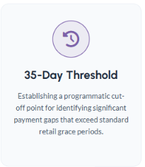
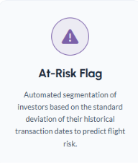
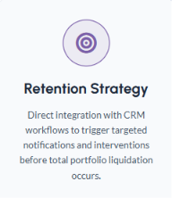
Churn Analysis: SIP Continuity

Slide 14
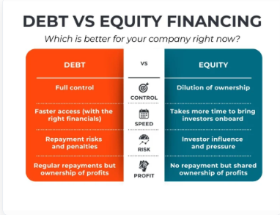
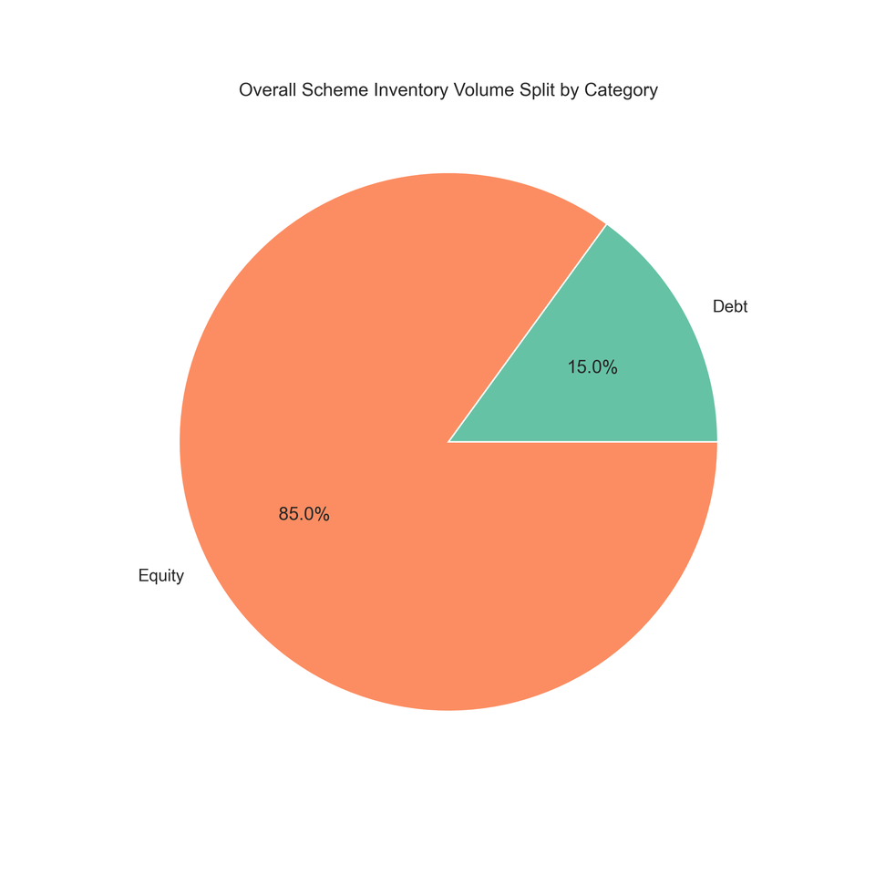


Market Sentiment: Net Inflows
Net Inflow Dynamics:
Analyzing capital migration across asset classes provides a real-time pulse of investor risk appetite and market sentiment shifts.
Category Momentum Analysis:
Equity Dominance: Sustained momentum in Equity Index categories for FY25, driven by long-term SIP retail confidence.
Debt Stagnation: Significant capital plateau observed in mid-term debt instruments as interest rate cycles stabilize.
Concentration Risk: HHI models indicate high sector concentration in sectoral equity inflows, requiring tactical rebalancing.

Slide 15

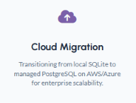
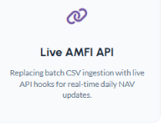
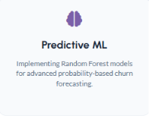
Future Roadmap & Q&A
Transitioning from MVP to Scalable Financial Intelligence

Slide 16

Thank You

